Slide 1
Field Effect Transistor

Slide 2
Objectives
In the end of this chapter, you’ll be able
  to understand and recognize the following two types of FET; JFET and MOSFET
  To discuss and differentiate the operation of each two types of FET

Slide 3
FET
FET’s (Field Effect Transistors) are much like BJT’s (Bipolar Junction Transistors).
Similarities:
    • Amplifiers
    • Switching devices
• Impedance matching circuits
  Differences:
• FET’s are voltage controlled devices whereas BJT’s are current controlled
devices.
• FET’s also have a higher input impedance, but BJT’s have higher gains.
• FET’s are less sensitive to temperature variations and because of there
construction they are more easily integrated on IC’s.
• FET’s are also generally more static sensitive than BJT’s.

Slide 4
FET Types
    • JFET ~ Junction Field-Effect Transistor
• MOSFET ~ Metal-Oxide Field-Effect Transistor
      - D-MOSFET ~ Depletion MOSFET
- E-MOSFET ~ Enhancement MOSFET

Slide 5
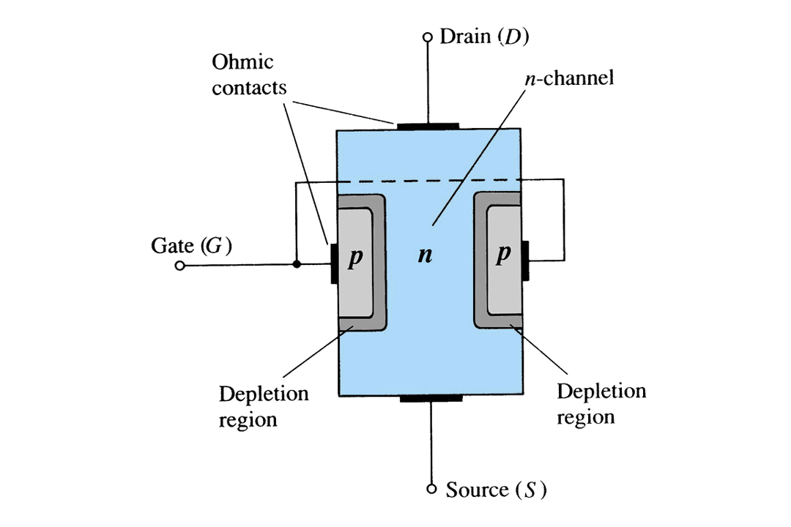

JFET Construction
There are two types of JFET’s: n-channel and p-channel.
The n-channel is more widely used.
There are three terminals: Drain (D) and Source (S) are connected to n-channel
Gate (G) is connected to the p-type material
How JFET works?

Slide 6
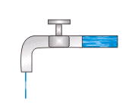
Basic Operation of JFET
JFET operation can be compared to a water spigot:
The source of water pressure – accumulated electrons at the negative pole of the applied voltage from Drain to Source
The drain of water – electron deficiency (or holes) at the positive pole of the applied voltage from Drain to Source.
The control of flow of water – Gate voltage that controls the width of the n-channel, which in turn controls the flow of electrons in the n-channel from source to drain.

Slide 7
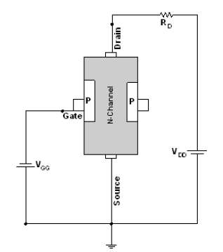
N-Channel JFET Circuit Layout

Slide 8
JFET Operating Characteristics
There are three basic operating conditions for a JFET:
    A. V_{GS} = 0, V_{DS} increasing to some positive value
B. V_{GS} < 0, V_{DS} at some positive value

Slide 9
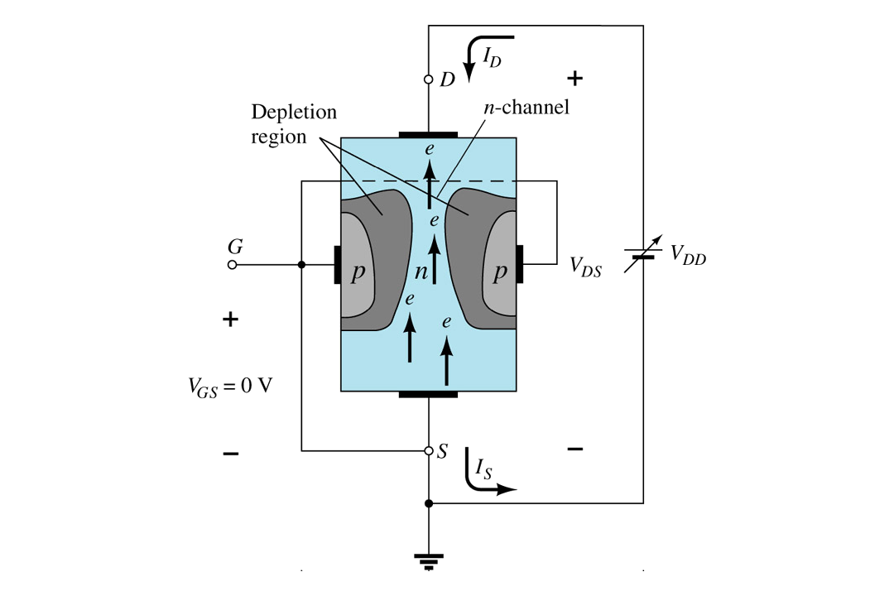
A. V_{GS} = 0, V_{DS} increasing to some positive value
Three things happen when V_{GS} = 0 and V_{DS} is increased from 0 to a more positive voltage:
    • the depletion region between p-gate and n-channel increases as electrons from
    n-channel combine with holes from p-gate.
    • increasing the depletion region, decreases the size of the n-channel which
    increases the resistance of the n-channel.
    • But even though the n-channel resistance is increasing, the current (I_{D}) from Source to Drain through the n-channel is increasing. This is because V_{DS} is increasing.

Slide 10
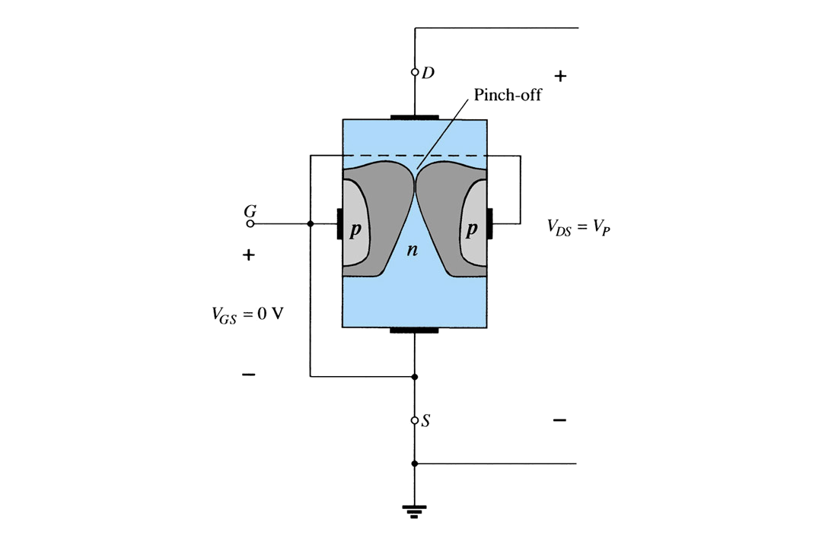
Pinch-off
If V_{GS} = 0 and V_{DS} is further increased to a more positive voltage, then the depletion zone gets so large that it pinches off the n-channel. This suggests that the current in the n-channel (I_{D}) would drop to 0A, but it does just the opposite: as V_{DS} increases, so does I_{D}.

Slide 11
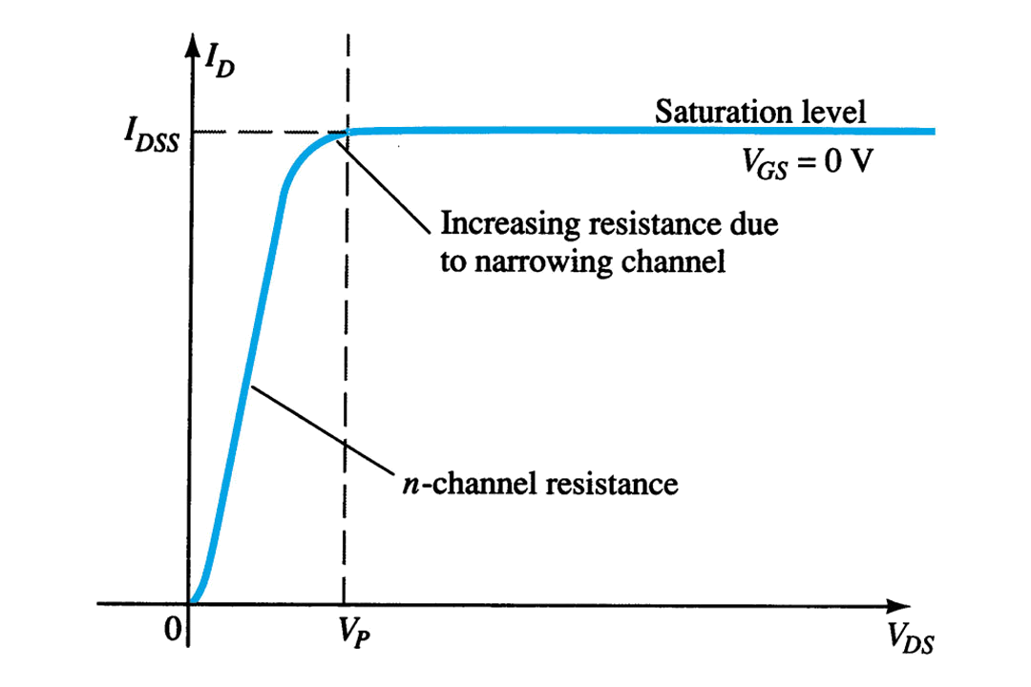
Saturation
At the pinch-off point:
    • any further increase in V_{GS} does not produce any increase in I_{D}. V_{GS} at
    pinch-off is denoted as Vp.
• I_{D} is at saturation or maximum. It is referred to as I_{DSS}.
• The ohmic value of the channel is at maximum.

Slide 12
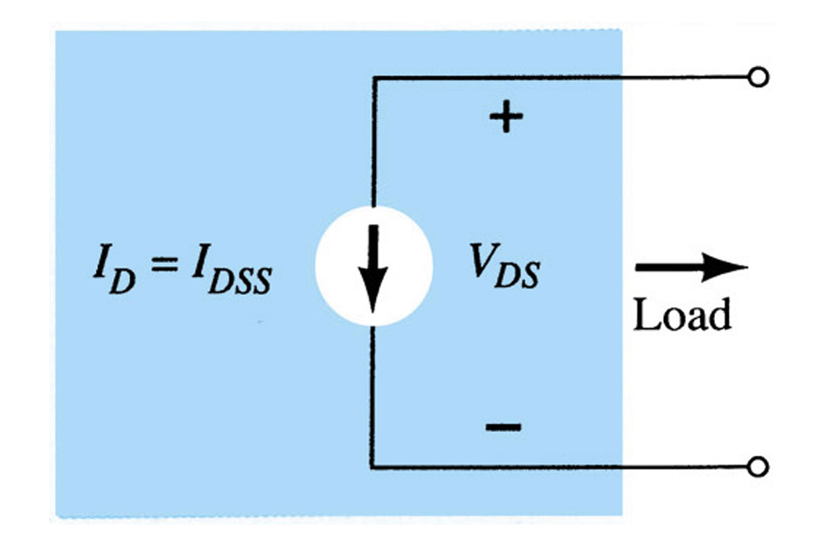
JFET modeling when I_{D}=I_{DSS}, V_{GS}=0, V_{DS}>V_{P}

Slide 13
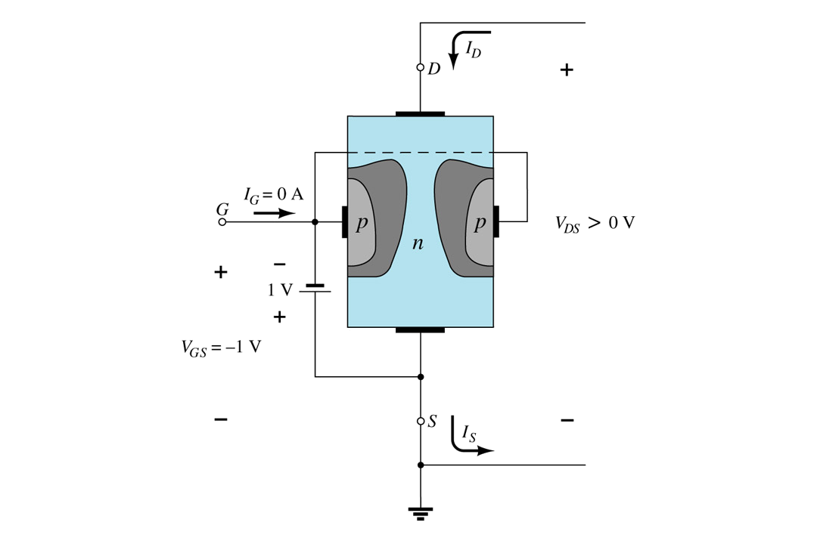
B. V_{GS} < 0, V_{DS} at some positive value
As V_{GS} becomes more negative the depletion region increases.

Slide 14
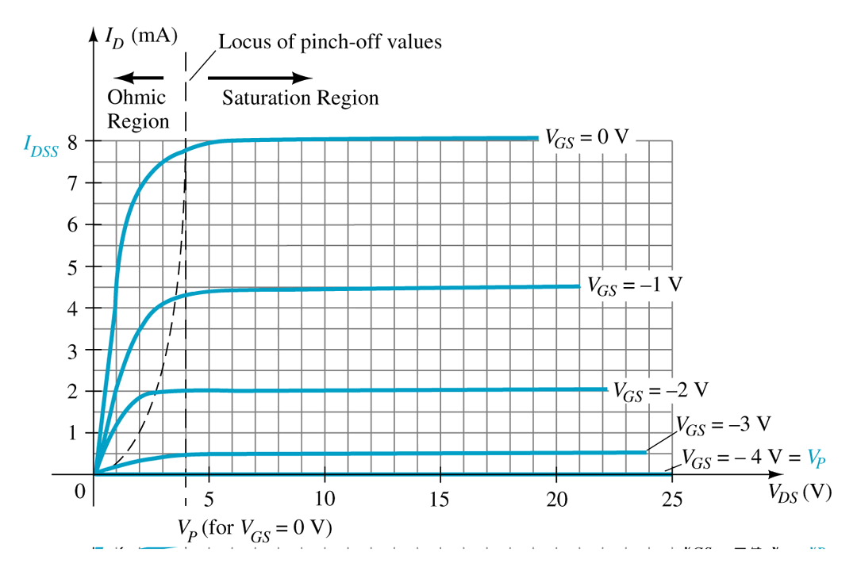
I_{D} < I_{DSS}
As V_{GS} becomes more negative:
    • the JFET will pinch-off at a lower voltage (V_{p}).
• I_{D} decreases (I_{D} < I_{DSS}) even though V_{DS} is increased.
• Eventually I_{D} will reach 0A. V_{GS} at this point is called Vp or V_{GS(off)}.
• Also note that at high levels of V_{DS} the JFET reaches a breakdown situation. I_{D} will increases uncontrollably if V_{DS} > V_{DSmax}.

Slide 15
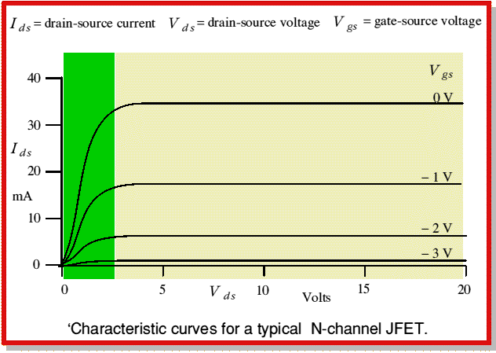
Characteristic curves for N-channel JFET

Slide 16
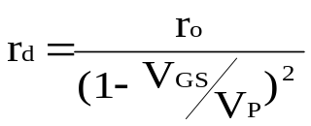
Voltage-Controlled Resistor
The region to the left of the pinch-off point is called the ohmic region.
The JFET can be used as a variable resistor, where VGS controls the drain-source resistance (r_{d}). As V_{GS} becomes more negative, the resistance (r_{d}) increases.

Slide 17
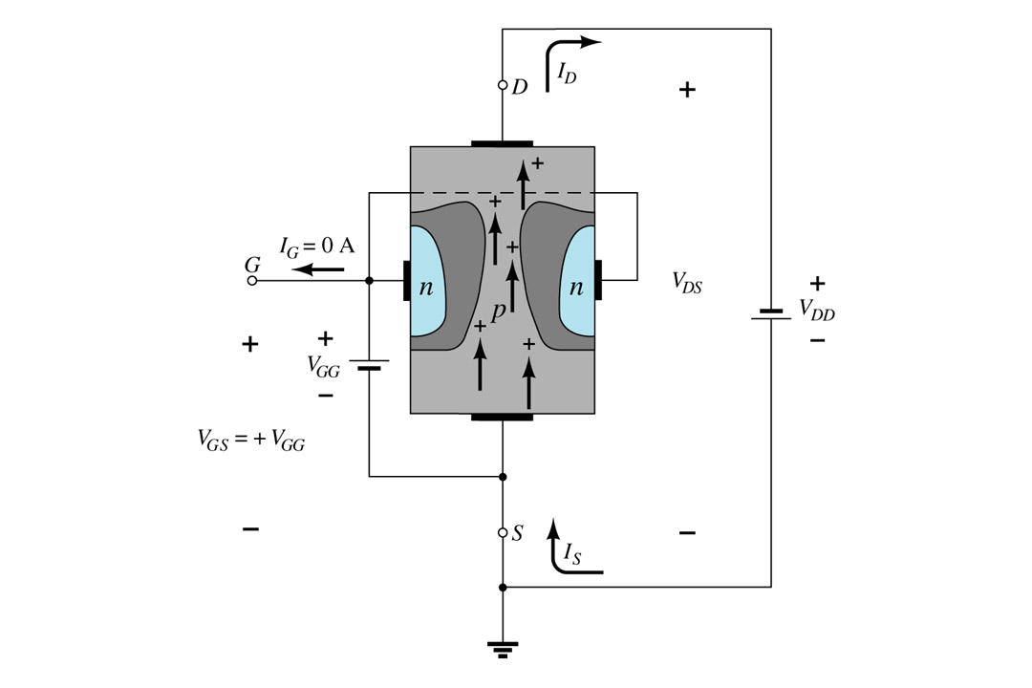
p-Channel JFETS
p-Channel JFET acts the same as the n-channel JFET, except the polarities and currents are reversed.

Slide 18
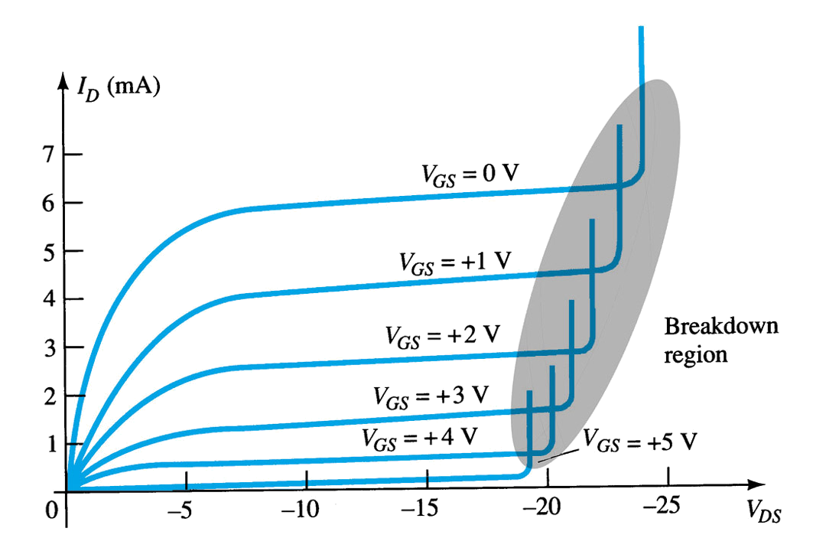
P-Channel JFET Characteristics
As V_{GS} increases more positively:
    • the depletion zone increases
• I_{D} decreases (I_{D} < I_{DSS})
• eventually I_{D} = 0A
Also note that at high levels of V_{DS} the JFET reaches a breakdown situation. I_{D} increases uncontrollably if V_{DS} > V_{DSmax}.

Slide 19
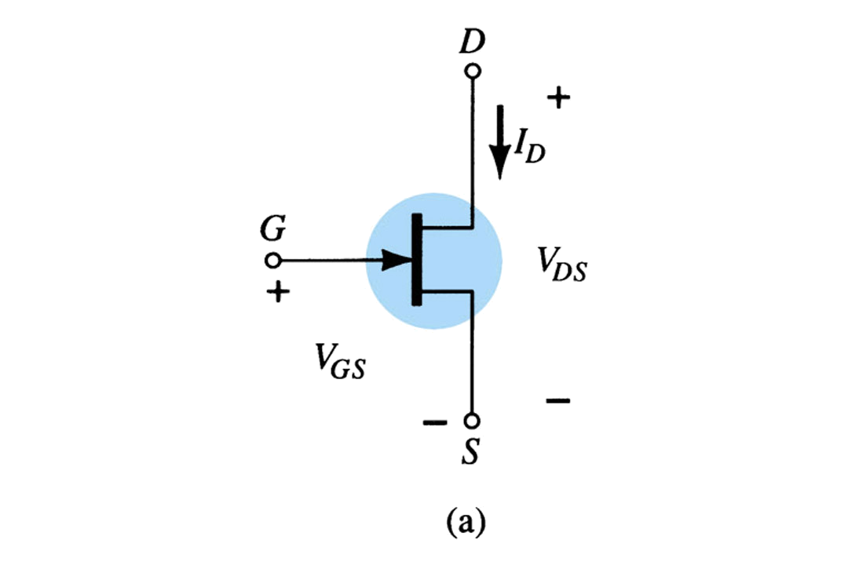
JFET Symbols

Slide 20
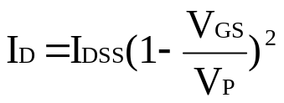
Transfer Characteristics
The transfer characteristic of input-to-output is not as straight forward in a JFET as it was in a BJT.
In a BJT, β indicated the relationship between I_{B} (input) and I_{C} (output).
In a JFET, the relationship of V_{GS} (input) and I_{D} (output) is a little more complicated:

Slide 21
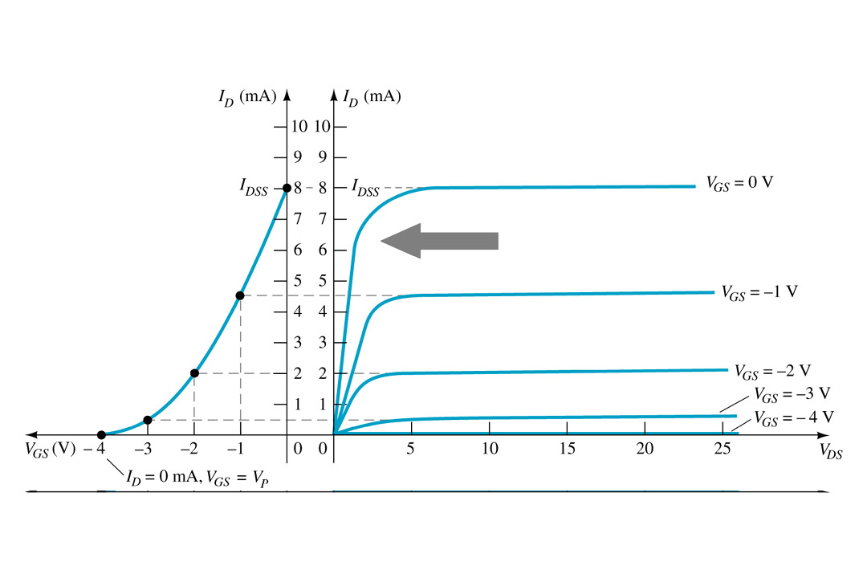
Transfer Curve
From this graph it is easy to determine the value of I_{D} for a given value of V_{GS}.

Slide 22
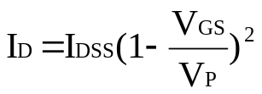

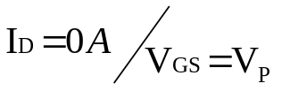
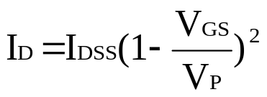
Slide 17
Plotting the Transfer Curve
Using I_{DSS} and Vp (V_{GS(off)}) values found in a specification sheet, the Transfer Curve can be plotted using these 3 steps:
Step 1:
Solving for V_{GS} = 0V:
Step 2:
Solving for V_{GS} = Vp (V_{GS(off)}):
Step 3:
Solving for V_{GS} = 0V to Vp:

Slide 23
Shorthand method
V_{GS} | I_{D}
0 | I_{DSS}
0.3V_{P} | I_{DSS}/2
0.5 | I_{DSS}/4
V_{P} | 0mA

Slide 24
Let’s try build a transfer characteristics..
Given that V_{p}=-6V and I_{DSS}=12mA. Draw the drain and transfer characteristics of a n channel JFET

Slide 25
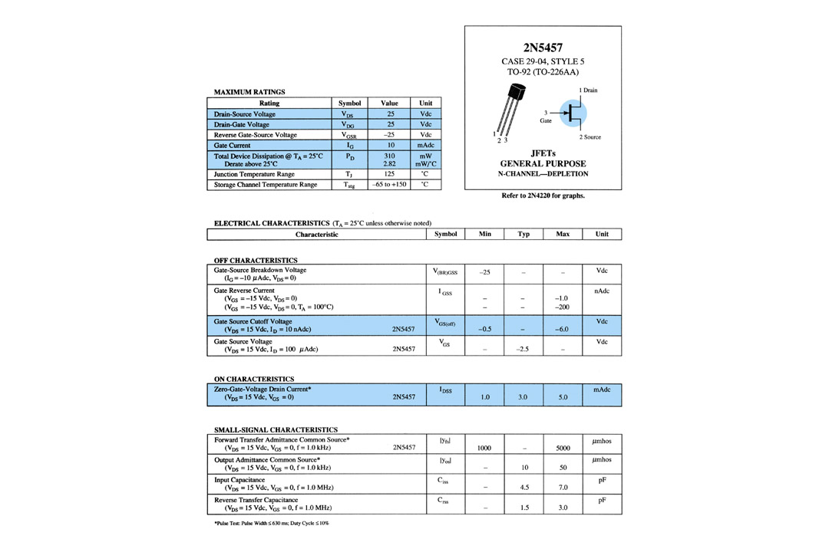
Specification Sheet (JFETs)

Slide 26
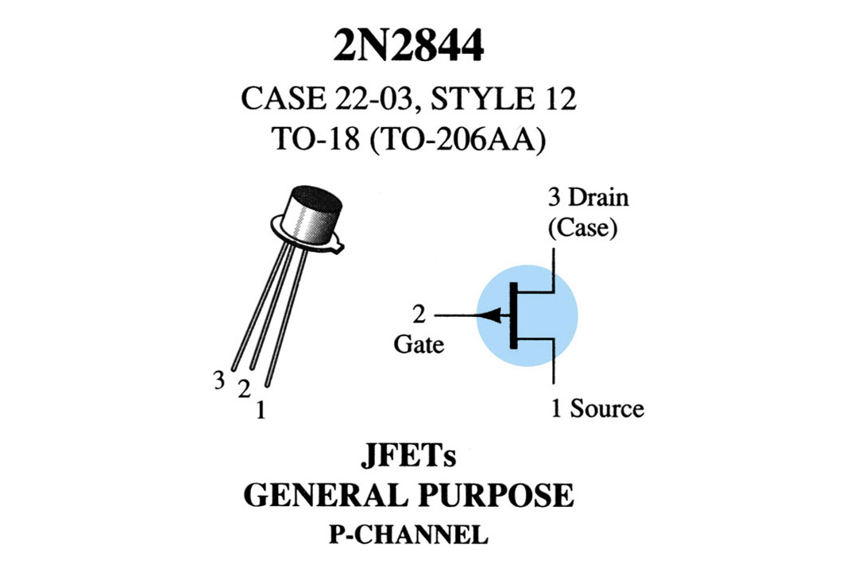
Slide 19
Case Construction and Terminal Identification
This information is also available on the specification sheet.

Slide 27
Testing JFET
a. Curve Tracer – This will display the I_{D} versus V_{DS} graph for various levels of V_{GS}.
b. Specialized FET Testers – These will indicate I_{DSS} for JFETs.
Robert Boylestad
Digital Electronics
Copyright ©2002 by Pearson Education, Inc.
Upper Saddle River, New Jersey 07458
All rights reserved.

Slide 28
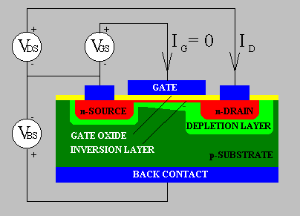
MOSFETs
MOSFETs have characteristics similar to JFETs and additional characteristics that make then very useful.
There are 2 types:
    • Depletion-Type MOSFET
• Enhancement-Type MOSFET

Slide 29
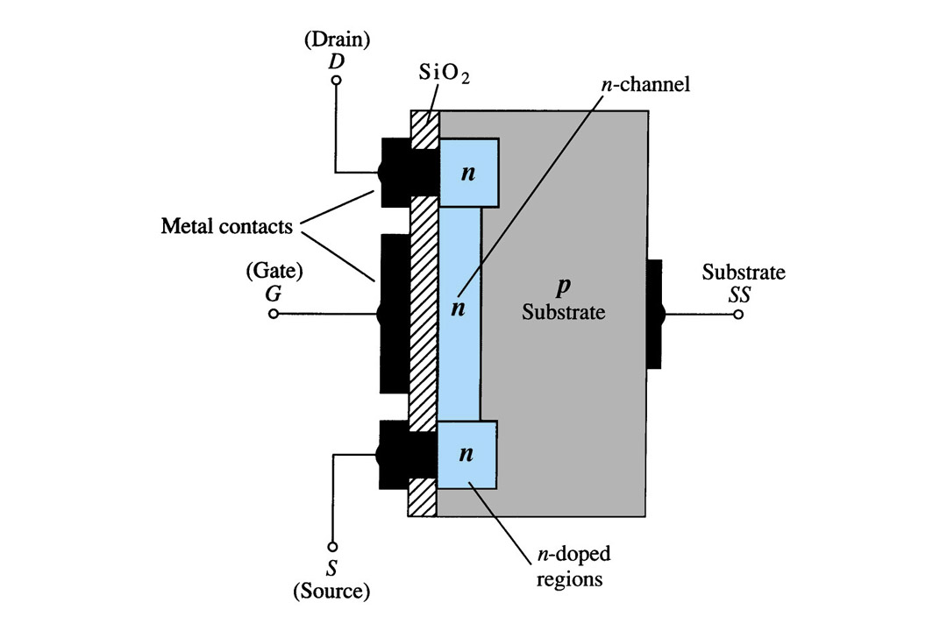
Depletion-Type MOSFET Construction
The Drain (D) and Source (S) connect to the to n-doped regions. These N-doped regions are connected via an n-channel. This n-channel is connected to the Gate (G) via a thin insulating layer of SiO₂. The n-doped material lies on a p-doped substrate that may have an additional terminal connection called SS.

Slide 30
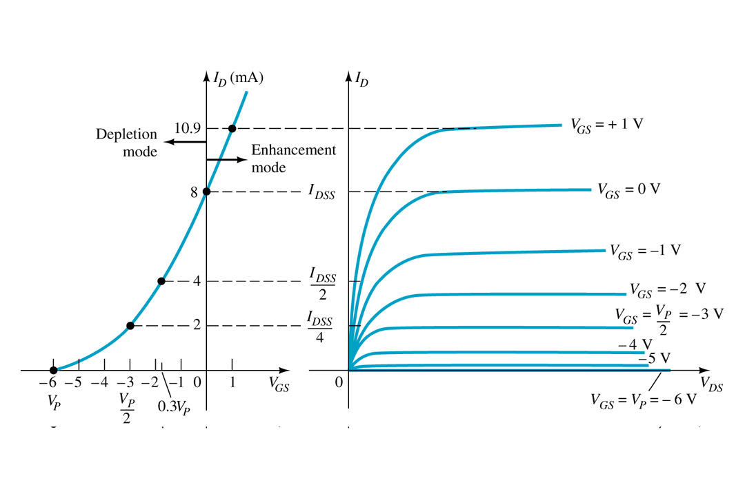
Basic Operation
A Depletion MOSFET can operate in two modes: Depletion or Enhancement mode.

Slide 31

Depletion-type MOSFET in Depletion Mode
Depletion mode
The characteristics are similar to the JFET.
When V_{GS} = 0V, I_{D} = I_{DSS}
When V_{GS} < 0V, I_{D} < I_{DSS}
The formula used to plot the Transfer Curve still applies:
[Formula 5.3]

Slide 32
Depletion-type MOSFET in Enhancement Mode
Enhancement mode
V_{GS} > 0V, I_{D} increases above I_{DSS}
The formula used to plot the
Transfer Curve still applies: [Formula 5.3]
(note that VGS is now a positive polarity)

Slide 33
So..did you understand how to sketch the transfer characteristics?
Sketch the transfer function for a n-channel depletion type MOSFET with I_{DSS}=12mA and V_{P}=-5V

Slide 34
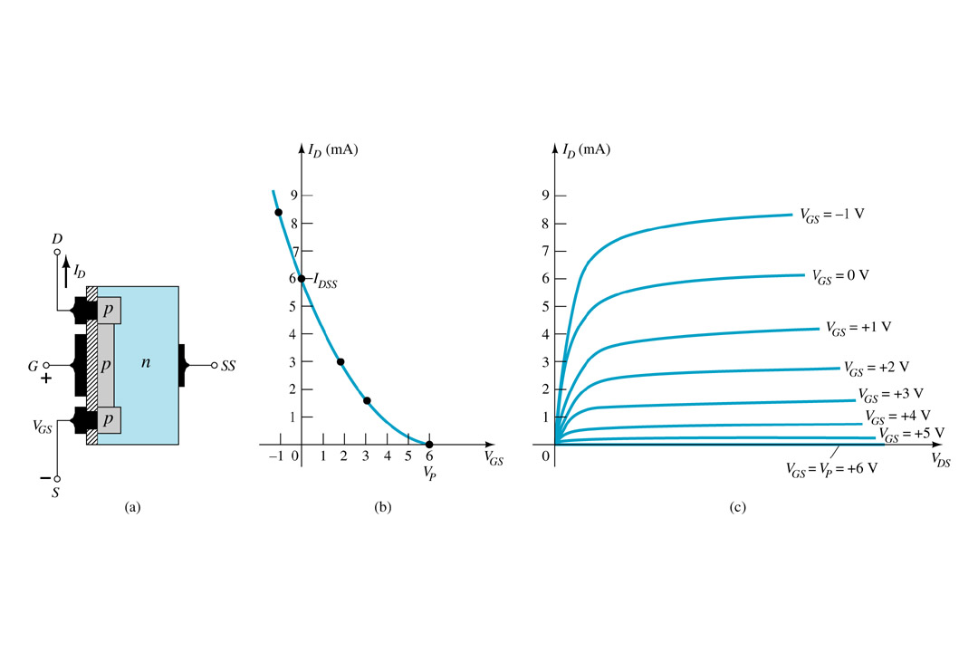
p-Channel Depletion-Type MOSFET
The p-channel Depletion-type MOSFET is similar to the n-channel except that the voltage polarities and current directions are reversed.

Slide 35
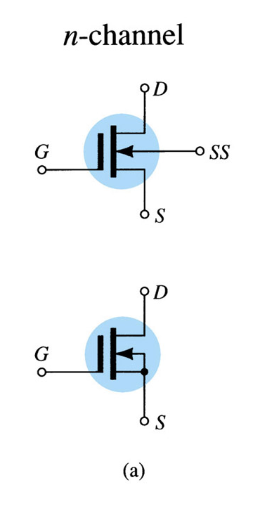
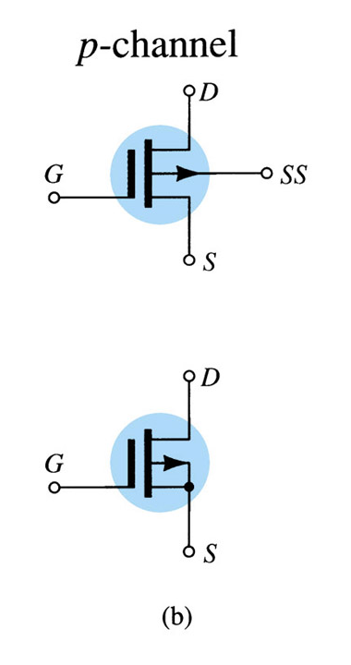
Symbols

Slide 36
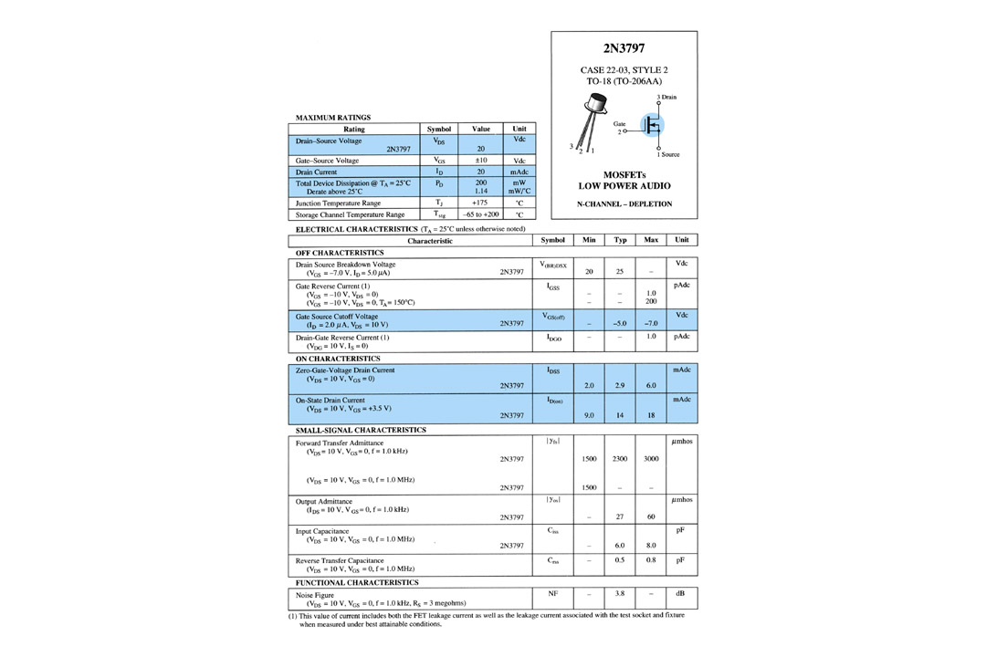
Slide 28
Specification Sheet

Slide 37
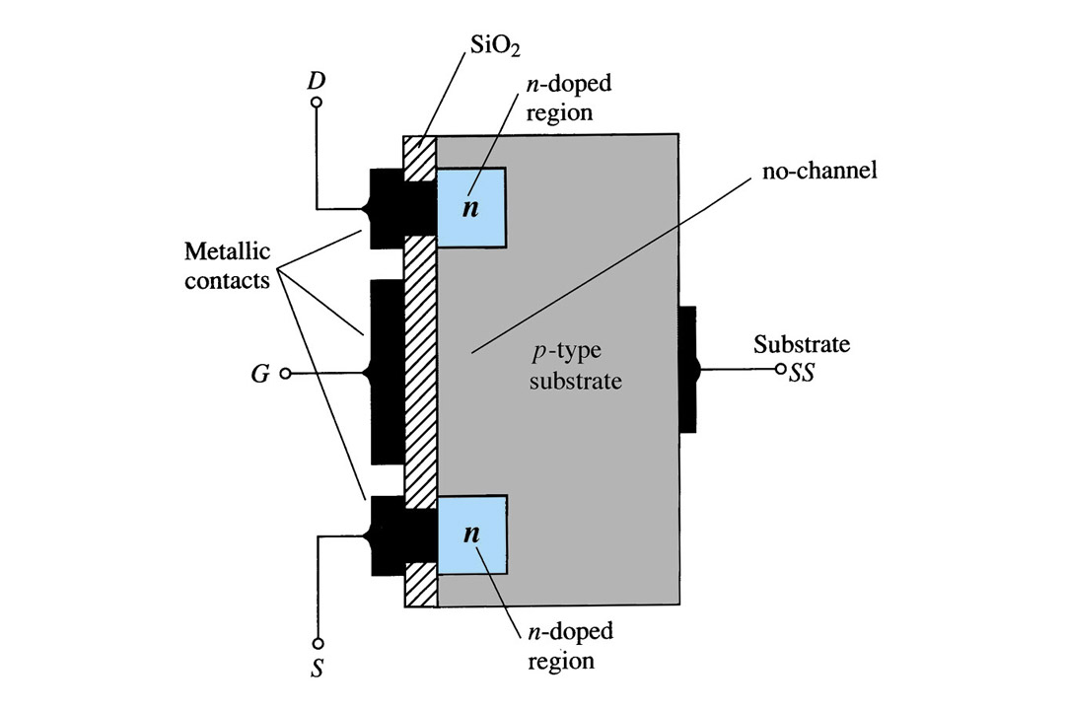
Enhancement-Type MOSFET Construction
Here the transfer curve is not defined by Schokley’s equation, and the drain current is now cut-off until the gate-to-source voltage reaches a specific magnitude, called the THRESOLD VOLTAGE.
The Drain (D) and Source (S) connect to the to n-doped regions. These n-doped regions are connected via an n-channel. The Gate (G) connects to the p-doped substrate via a thin insulating layer of SiO₂. There is no channel. The n-doped material lies on a p-doped substrate that may have an additional terminal connection called SS.

Slide 38
What is ‘Thresold Voltage’?
The level of VGS that results in the significant increase in drain current is called the Thresold voltage and is given by the symbol VT

Slide 39
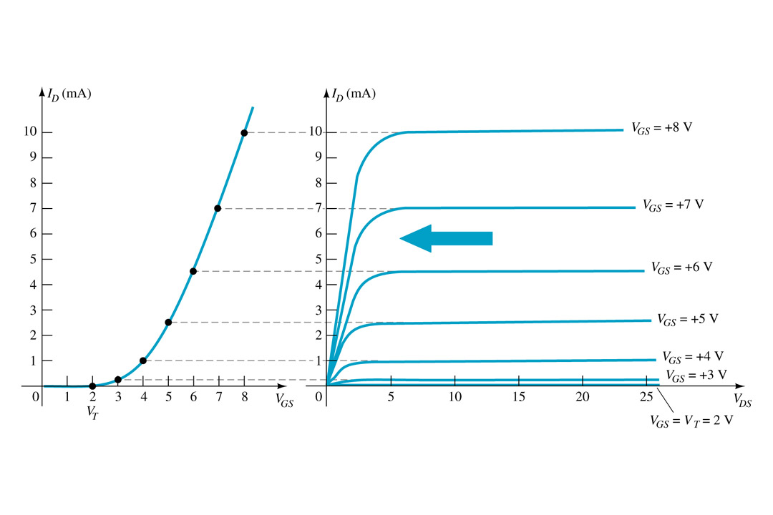

Slide 30
Basic Operation
The Enhancement-type MOSFET only operates in the enhancement mode.
V_{GS} is always positive
As V_{GS} increases, I_{D} increases
But if V_{GS} is kept constant and V_{DS} is increased, then I_{D} saturates (I_{DSS})
The saturation level, V_{DSsat} is reached.
[Formula 5.12]

Slide 40

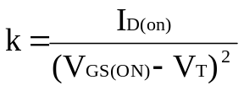

Transfer Curve
To determine I_{D} given V_{GS}: [Formula 5.13]
where V_{T} = threshold voltage or voltage at which the MOSFET turns on.
k = constant found in the specification sheet
k can also be determined by using values at a specific point and the formula:
[Formula 5.14]
V_{DSsat} can also be calculated:
[Formula 5.12]

Slide 41
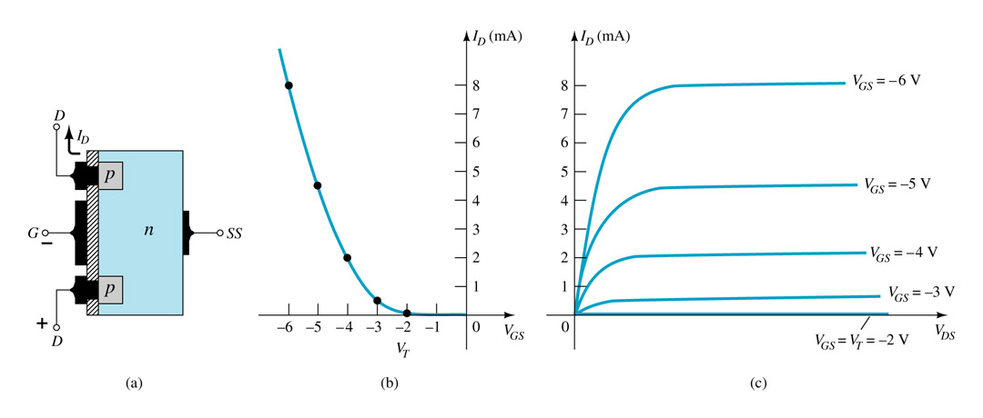
Slide 32
p-Channel Enhancement-Type MOSFETs
The p-channel Enhancement-type MOSFET is similar to the n-channel except that the voltage polarities and current directions are reversed.

Slide 42
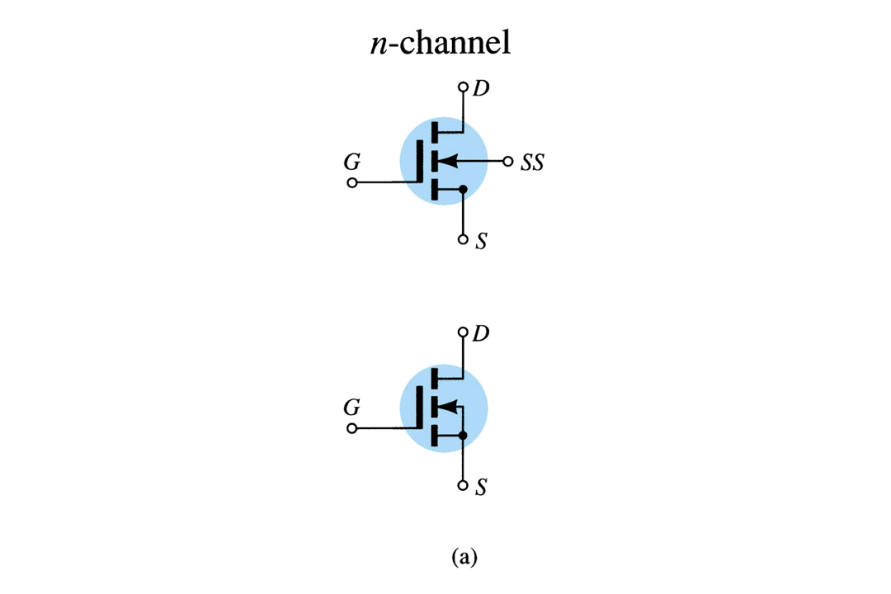
Symbols

Slide 43
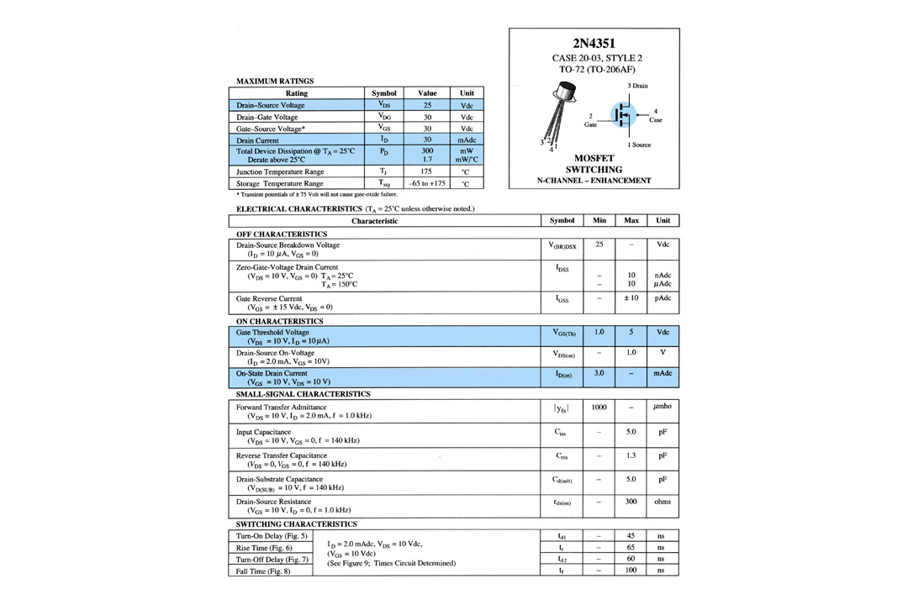
Slide 34
Specification Sheet

Slide 44
MOSFET Handling
MOSFETs are very static sensitive. Because of the very thin SiO₂ layer between the external terminals and the layers of the device, any small electrical discharge can stablish an unwanted conduction.
Protection:
    • Always transport in a static sensitive bag
• Always wear a static strap when handling MOSFETS
• Apply voltage limiting devices between the Gate and Source, such as back-to-
back Zeners to limit any transient voltage.

Slide 45
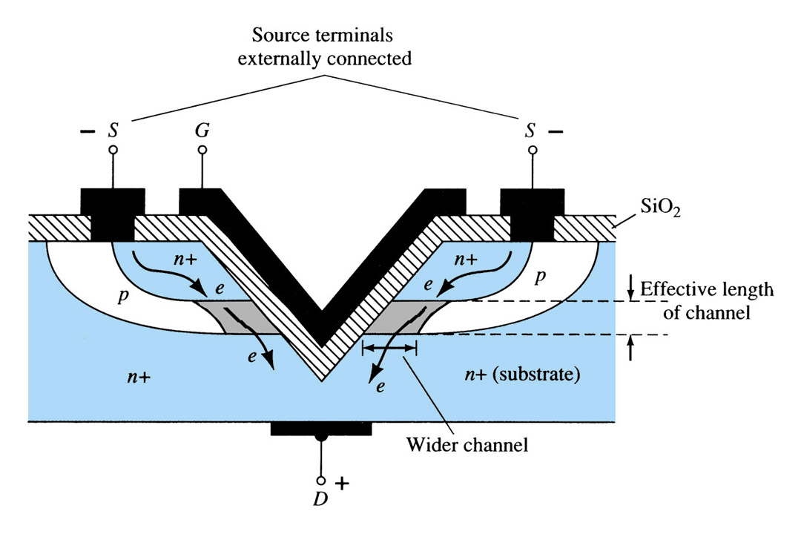
VMOS
VMOS – Vertical MOSFET increases the surface area of the device.
Advantage:
    • Reduced channel resistance.This allows the device to handle higher currents, power by providing it more surface area to dissipate the heat.Positive temp.co-eff.combat the possibility of thermal runaway.
• VMOSs also have faster switching times.

Slide 46
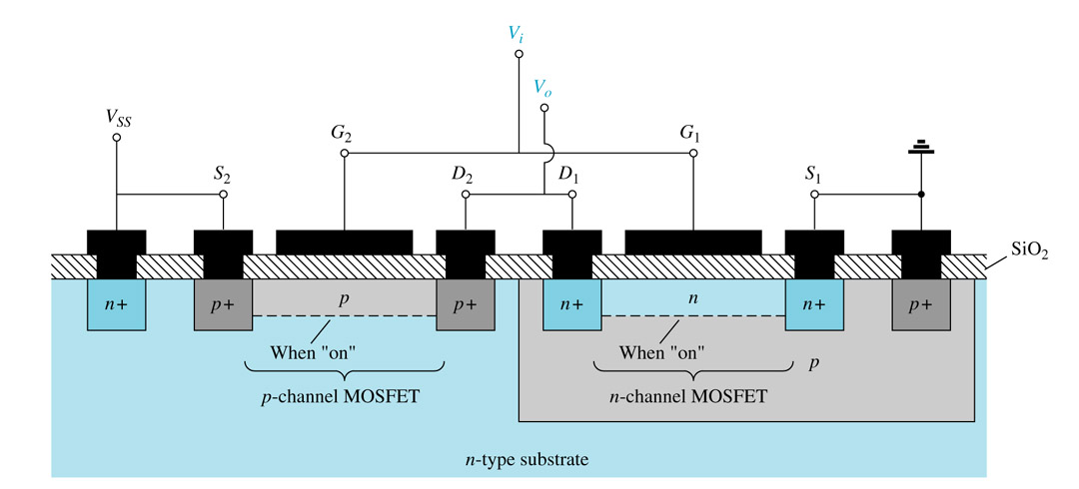
CMOS
CMOS – Complementary MOSFET p-channel and n-channel MOSFET on the same
substrate.
Advantage:
    • Useful in logic circuit designs
• Higher input impedance
• Faster switching speeds
• Lower operating power levels

Slide 47
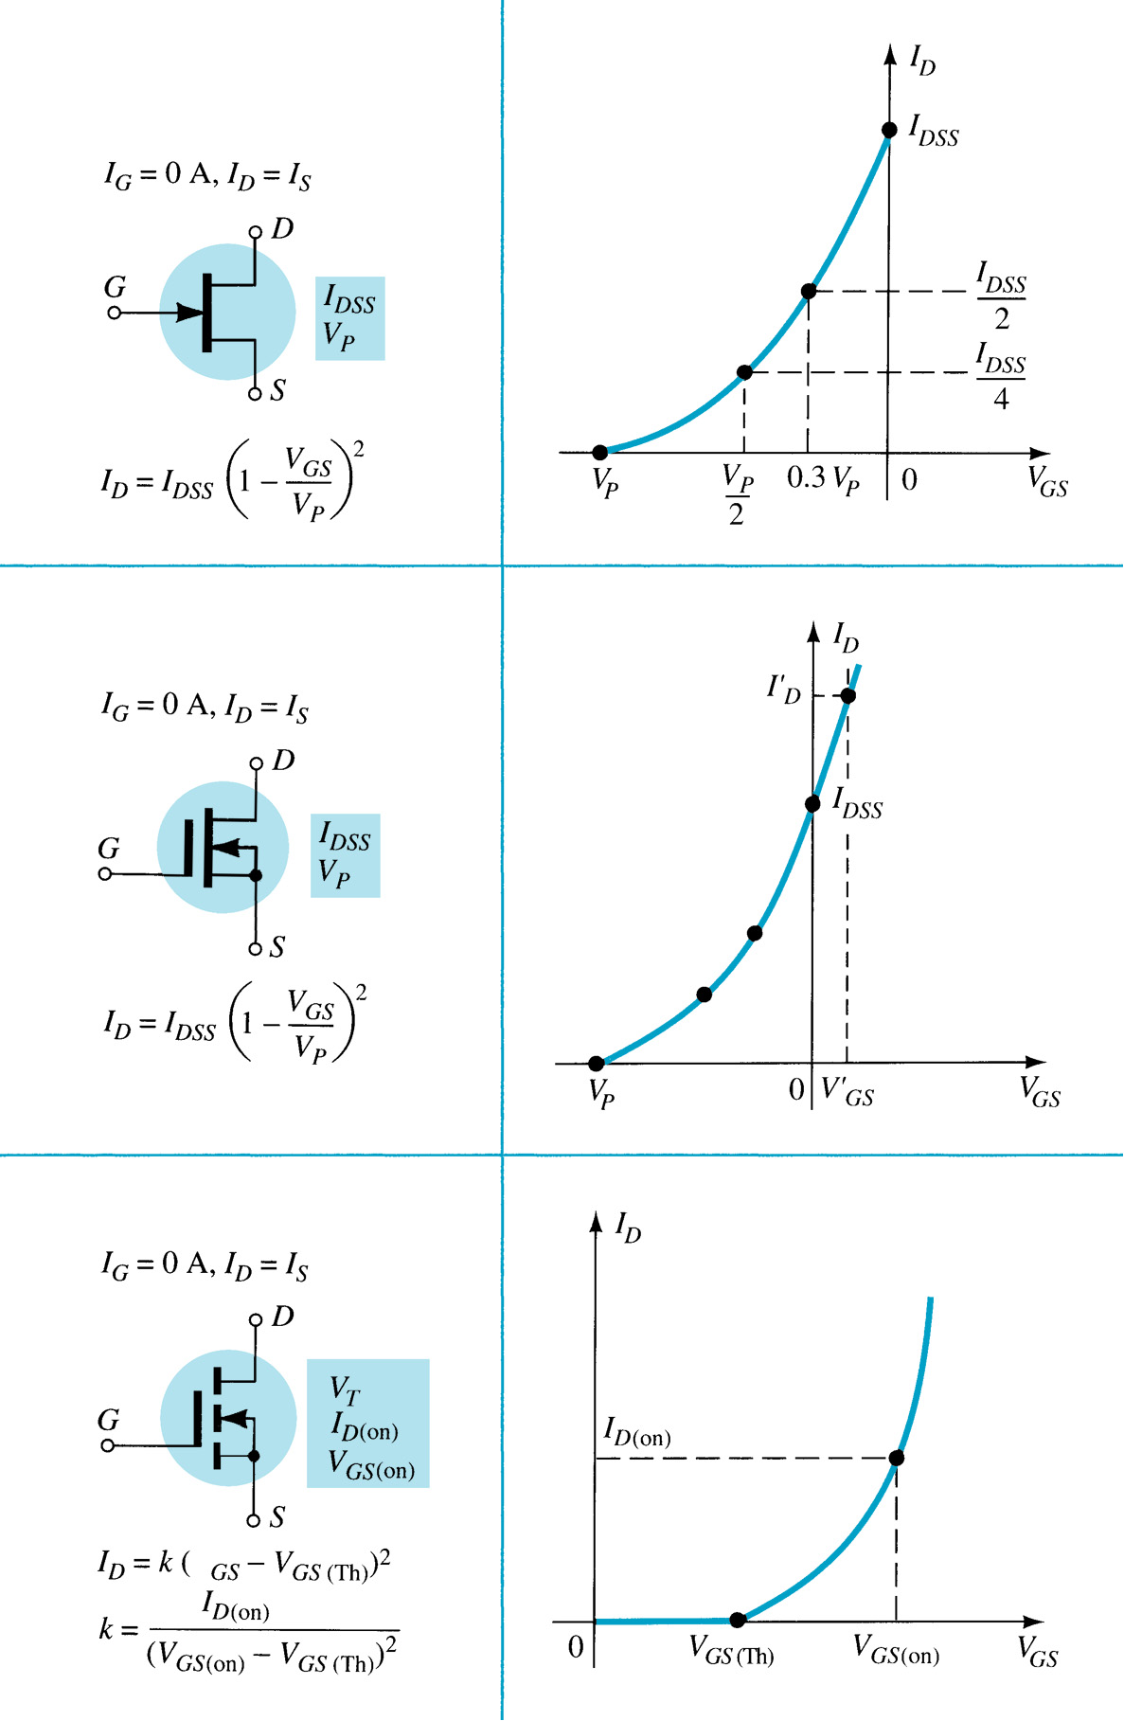
Summary Table

